Slide 1
Meet the Teacher

Slide 2
Welcome to Reception
Staff Members
Sharon Donaldson sharon.donaldson@amblefirst.northumberland.sch.uk
Barbara Mallaburn
Helen Poulton
Please note that emails will only be responded to during school working hours.

Slide 3
Our Curriculum
Our curriculum is the final year of the Foundation Stage. Children work on a number of key skills and begin their reading and writing journeys.
Our curriculum is based on areas of learning rather than specific subjects -
Prime - Communication and Language, Personal social and emotional development and physical development
Specific - Literacy, Maths, Expressive art and design, Knowledge and understanding of the world

Slide 4
Our Curriculum
We break the curriculum into specific questions which we aim to answer over a half term. This half term our focus is ‘What makes me special?’
Further information about this can be found on the school website.
http://www.amblefirst.northumberland.sch.uk/web/

Slide 5
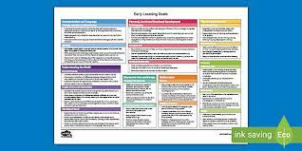
Assessments
At the beginning of the year all children in Reception complete the Reception baseline - a government initiative to record how many children are on track.
Over the year we regularly assess children to determine whether they are ‘on track’ to achieve the end of year Early Learning Goals. If children achieve the early learning goals they will have achieved their ‘Good Level of Development’ meaning they are on track for year one.

Slide 6
Sharing Learning
We encourage parents to regularly share learning using tapestry.
We also regularly report to parents about their child’s individual learning journey - we hold 3 parents evenings a year and reports also go home in July.

Slide 7
Learning at home
The children will bring home a new learning log grid each half term. We ask that one activity be completed each week and added to tapestry.
We also ask that children read regularly with an adult, ideally 4 times a week when they begin to bring home reading books.

Slide 8
Did you know…
In 2014, 88% of children 0–2 spent up to one hour a day on screen but by 2019, spending up to one hour a day had dropped to 48% of 0–2s. Meanwhile, those 0–2s spending 1–3 hours a day on screen grew from 11% in 2014 to 42% in 2019. When used appropriately with a parent, technology can provide an important route in to reading. Our challenge is engaging parents with this, because data shows that 0–2s use a tablet ‘most often’ to visit YouTube (26%).

Slide 9
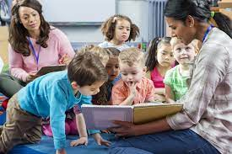
Did you know…
7 Benefits of Reading to Children
Supported cognitive development.
Improved language skills.
Preparation for academic success.
Developing a special bond with your child.
Increased concentration and discipline.
Improved imagination and creativity.
Cultivating a lifelong love of reading

Slide 10
Supporting Learning
We have many opportunities in school to support your child’s learning. We hold regular reading breakfasts and parent drop ins.
We also hold meetings to provide information on RWI etc.
Look out for our secret reader challenge too!

Slide 11
Attendance
It is imperative children attend school as regularly as possible. National expectations aim for 97% attendance which isn’t much time off!
If your child is genuinely ill please contact the school office as soon as possible.
If you are going on holiday forms must be completed and handed in 2 weeks in advance. Please be honest - the children do tell us where they have been!

Slide 12
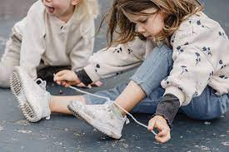
School Uniform
School Uniform is available to purchase on the school website.
PE days do change each half term - please look out for these!
Please ensure your child is in uniform or PE kit each day. Please also note that children cannot take part in PE if earrings are worn.
No laces please!!

Slide 13
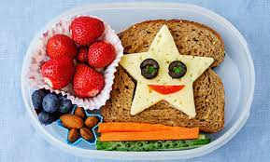
What your child needs…
School uniform
A book bag
A water bottle (named)
Packed lunch (please keep these as healthy as possible - no chocolate or fizzy pop)

Slide 14
Information
We aim to share information is as many different ways as possible to keep parents up to date and we do try and give as much notice as we can for events.
Tapestry
Website
Facebook
Newsletters
Email

Slide 15
Questions or Concerns
If you have a question or are worried about your child please do not hesitate to get in touch. Please, please come to us first via either a phone call, email or tapestry observation. We are always here to help!

Slide 16
Home / School agreement
And finally….

Slide 17
Questions…

