Slide 1

Respect Happiness Growth
If you’re ready to try, you’re ready to fly.

Slide 2
Respect Happiness Growth
Key Stage 1 2025-26

Slide 3
Teachers
Year 1
Mrs Hunter / Miss Wilkie
Supported by Mrs Brown
Year 2
Mrs Balding / Miss Wilkie
Supported by Mrs Durham

Slide 4

Communication
Communication
If you need to speak to your child’s teacher, pass a message to staff at the door, contact the school office, or speak to us on the yard after school.
Parents’ evening will be the week of Monday 13th October—a chance to hear how your child has settled.
See our school website’s Facebook news feed for updates and photos of learning.

Slide 5

Responsibilities
Independence
Children are expected to organise their belongings each morning and bring books into class. Please encourage your child to pack their own bag so they know what’s inside. Staff are in the cloakroom to remind them.
In class, children take on responsibilities (e.g. register monitor, organising resources) to build independence. This year we’ve also elected Team RRS—an exciting new opportunity.

Slide 6

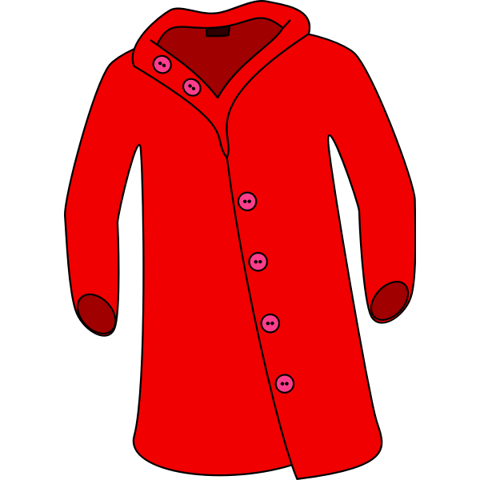

Reminders
Belongings & Uniform
Bring a coat daily; hats and gloves will be needed soon.
Label all uniform and belongings.
Bring a named water bottle (water only, refillable in school).
No earrings. Plastic retainers can be worn if piercings are new.
Only small bags (e.g. book bags) due to cloakroom space.
Any medication must go to the school office—children should not carry it

Slide 7
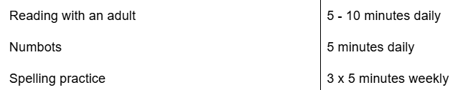
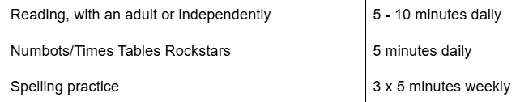
Homework
Homework has been changed this year.
Each half term, your child will receive a letter, outline a project that they should complete. This does not normally need handing in until the last week of term.
This is additional to weekly homework, which must be completed.
Year 1 Expectations
Year 2 Expectations

Slide 8
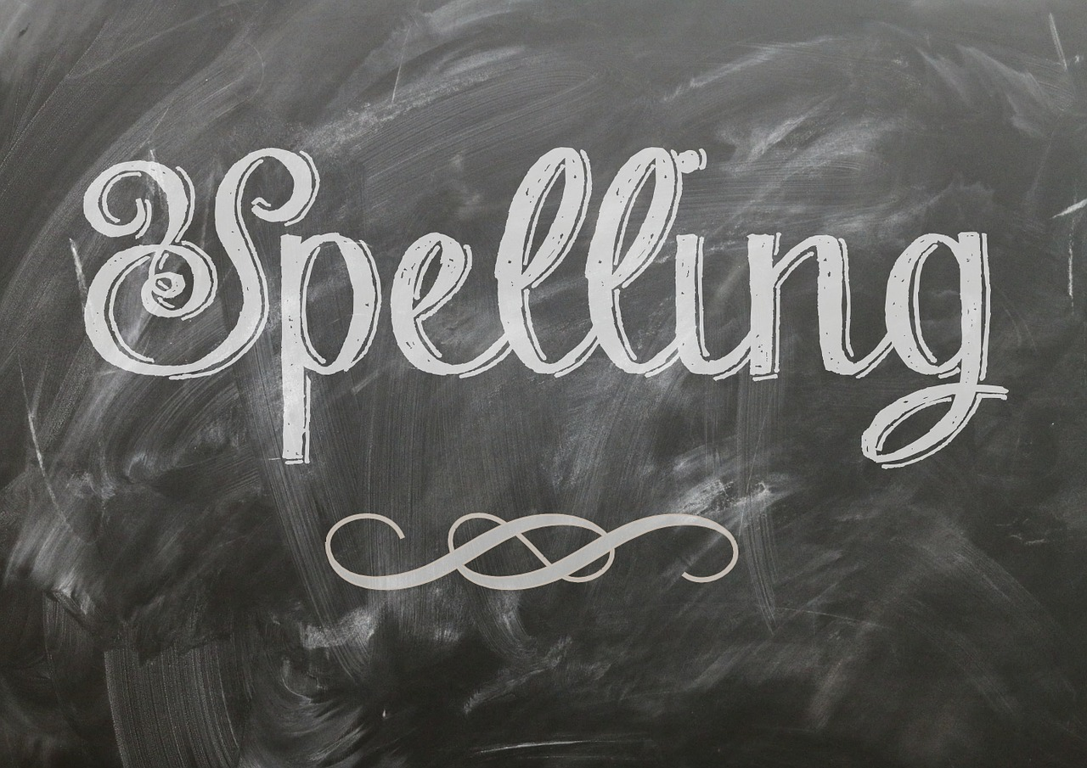
Homework: Spellings
Children will be given some spellings to learn each week. These are based on our English text. We encourage them to practice these as often as possible- a couple of minutes a day can make a big difference!
Top tips for spelling!
Highlight any “special friends” p l ay
Fred Talk the sounds p l ay
. .
Write out the word

Slide 9

Homework
Reading Books
Each week, your child will bring home two books: one at their level and one library book to share with a grown-up. Please record when they read. Encourage them to use ‘special friends,’ ‘Fred talk,’ and discuss the story together.
Children read daily in lessons and once a week with an adult. Books can be changed any day, so please bring them daily.
Our weekly “Read to Lead” challenge rewards children who read 4+ times a week with a dip in the prize box!
We’ve also sent home our first Safari Reading Challenge—let’s see how many complete it this half term!

Slide 10
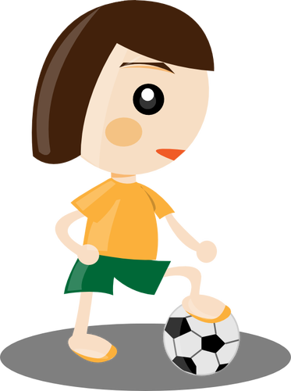
Uniform/PE days
Our PE days this term are:
Year 1 Tuesday and Thursday
Year 2 Monday and Wednesday
PE days can change from term to term depending if children are working with the coaches from NUFC. We will let you know when PE days change.
Children need to wear the schools new PE kit that day which is; black leggings / joggers, trainers, a white t-shirt and plain black hoodie.
Jewellery must not be worn in school. Plastic earring retainers may be worn in place of earrings.

Slide 11
Online Safety
We teach children about online safety throughout the year and we also have a whole school assembly each half term covering a range of themes.
If you have any concerns about online safety or need general advice…
https://www.ceopeducation.co.uk/parents/
To report any concerns/incidences regarding your child’s safety:
https://www.ceop.police.uk/Safety-Centre/

Slide 12
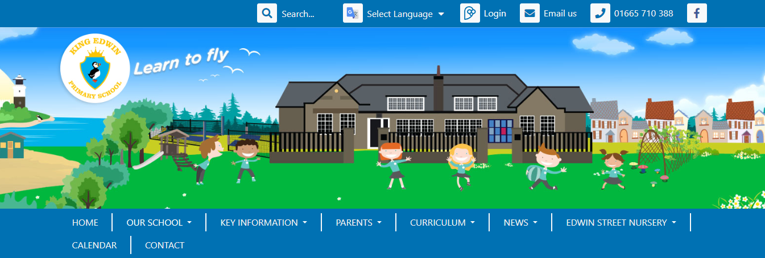
Curriculum
http://www.amblefirst.northumberland.sch.uk/web
All of the information you need about school is available on our website.
There is a ‘curriculum’ tab where you will find the class pages
Notes:
Name of website will change soon!

Slide 13
New Whole-School Behaviour Policy
We have 3 new rules to help everyone learn and feel happy:
✅ Be Ready
✅ Be Respectful
✅ Be Safe

Slide 14
✅ Be Ready
Be Ready means:
🎒 Bring what you need to school
👂 Listen carefully
🙋 Be ready to learn and try your best

Slide 15
✅ Be Respectful
Be Respectful means:
🙂 Be kind to everyone
🗣️ Use polite words
👫 Take turns and share

Slide 16
✅ Be Safe
Be Safe means:
🚶 Walk inside the school
🙋 Tell an adult if something’s wrong
🤲 Keep hands and feet to yourself

Slide 17
What Happens if You Forget the Rules
😟 Sometimes we make mistakes. That’s OK — it’s how we learn!
Here’s what happens …

Slide 18
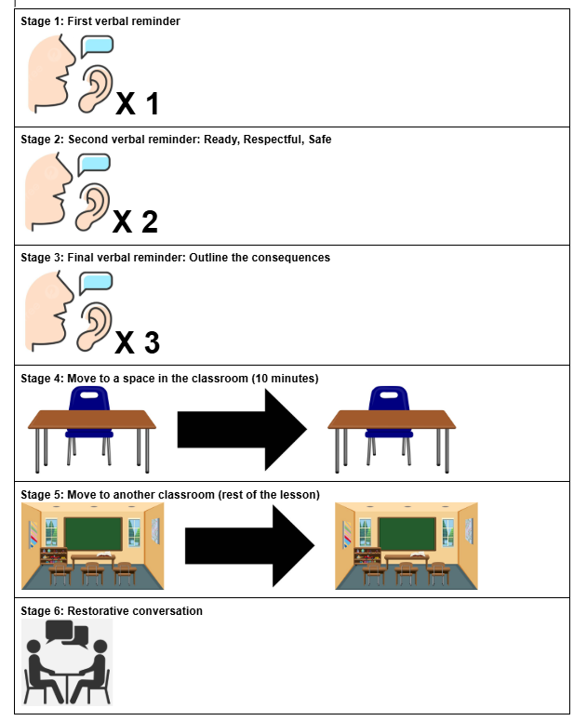
Staged response
For if you forget the rules.

Slide 19
Any Questions?

