Slide 1

Respect Happiness Growth
If you’re ready to try, you’re ready to fly.

Slide 2
Respect Happiness Growth
Key Stage 1 2026-27

Slide 3
Teachers
Year 1
Mrs Hunter / Miss Wilkie
Supported by Mrs Brown
Year 2
Mrs Graham (Monday, Tuesday, Wednesday am)
Miss Wilkie (Wednesday pm)
Miss Kiernan (Thursday & Friday)
Supported by Mrs Durham

Slide 4

Communication
Communication
If you need to speak to your child’s teacher, pass a message to staff at the door, contact the school office, or speak to us on the yard after school.
Parents’ evening will be the week of Monday 12th October—a chance to hear how your child has settled.
See our school website’s Facebook news feed for updates and photos of learning.

Slide 5

Responsibilities
Independence
Children are expected to organise their belongings each morning and bring books into class. Please encourage your child to pack their own bag so they know what’s inside. Staff are in the cloakroom to remind them.
In class, children take on responsibilities (e.g. register monitor, organising resources) to build independence. This year all children will experience being on Team RRS where they will work on whole school projects.

Slide 6



Reminders
Belongings & Uniform
Bring a coat daily; hats and gloves will be needed soon.
Label all uniform and belongings.
Bring a named water bottle (water only, refillable in school).
No earrings. Plastic retainers can be worn if piercings are new.
Only small bags (e.g. book bags) due to cloakroom space.
Any medication must go to the school office—children should not carry it.

Slide 7
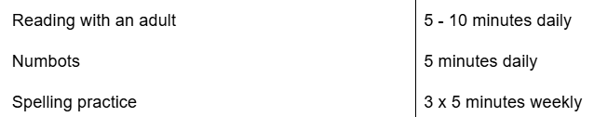
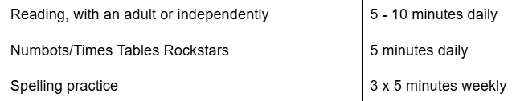
Homework
Each half term, your child will receive a letter, outlining a project to complete. This does not normally need handing in until the last week of term.
This is additional to weekly homework, which must be completed.
Year 1 Expectations
Year 2 Expectations

Slide 8

Homework: Spellings
Children will be given some spellings to learn each week. We encourage them to practice these as often as possible- a couple of minutes a day can make a big difference!
Top tips for spelling!
Highlight any “special friends” p l ay
Fred Talk the sounds p l ay
. .
Write out the word

Slide 9

Reading
Reading Books
Each week, your child will bring home two books: one at their reading level and one library book to share with a grown-up. Please record when they read in their reading record. If your child is struggling, encourage them to use ‘special friends,’ ‘Fred talk,’ and discuss the story together.
Children read daily in lessons and at least once a week with an adult. Books can be changed any day, so please bring them daily.
Bronze Boot Challenge

Slide 10
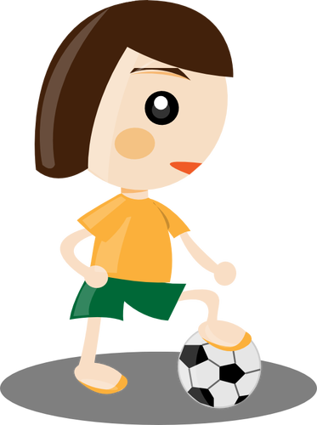
Uniform/PE days
Our PE days this term are:
Year 1 Tuesday and Thursday
Year 2 Monday and Thursday
PE days can change from term to term depending if children are working with the coaches from NUFC. We will let you know when PE days change.
Children need to wear the schools new PE kit that day which is; black leggings / joggers, trainers, a white t-shirt and plain black hoodie.
Jewellery must not be worn in school. Plastic earring retainers may be worn in place of earrings.

Slide 11
Attendance
Every day counts!
We know that sometimes children are unwell or things happen that are out of our control. Thank you for working with us to make sure your child gets the most from their time at school.
If your child is absent
Please let school know as soon as possible if your child is going to be absent. This helps us avoid having to contact you.
Please let us know each day your child is absent, unless you have already agreed otherwise with school.
Please give us an honest reason for your child's absence. Please don't encourage your child to give a different reason – this can make things uncomfortable for everyone, and we will usually need to clarify the circumstances.

Slide 12
Being on time
Being late can be unsettling for children and can be awkward when they arrive after the rest of the class has started.
Even a short amount of missed time can mean missing important learning and routines.
If your child arrives late, please come to the office where you have to report your reason for being late.

Slide 13
Attendance matters
If attendance falls below 92%, we will contact you to discuss this.
Attendance below 90% is classed as persistent absence and will be monitored closely.
Holidays during term time
If you need to request a holiday during term time, please complete a holiday request form at least 2 weeks in advance.
Please remember that holidays during term time are not automatically authorised.

Slide 14
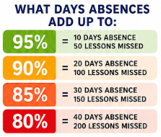

Slide 15
New information - medication, address, phone numbers - please keep school up to date asap
At least 4 contacts needed.
Email office if anything changes.
Medication - please do not put in child’s bag. This includes non-prescription items.
Form must be completed at the office.
Long term = Individual health Care Plan (contact office to do this).

Slide 16
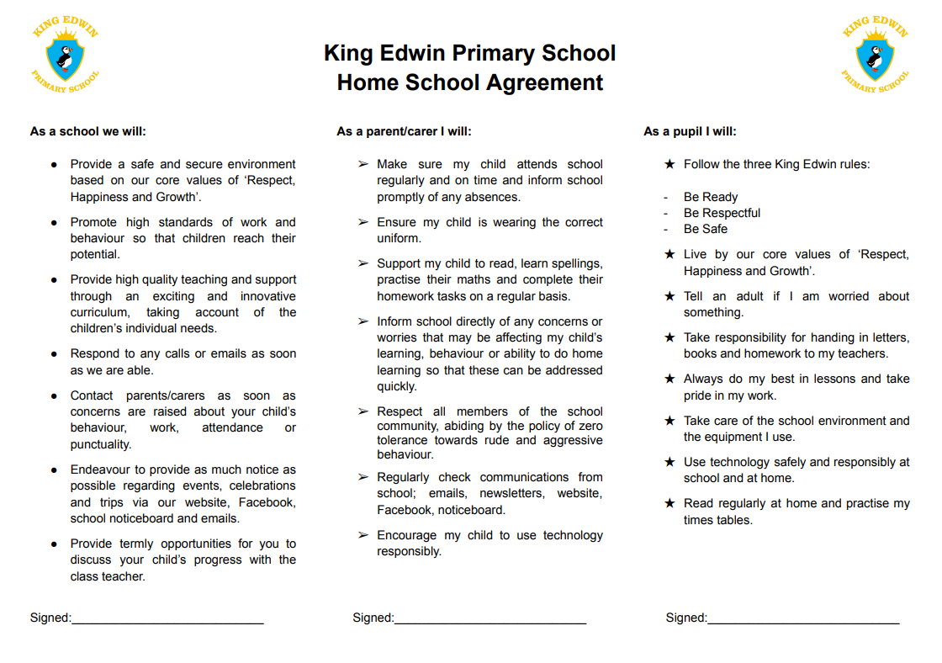

Slide 17
Online Safety
We teach children about online safety throughout the year and we also have a whole school assembly each half term covering a range of themes.
If you have any concerns about online safety or need general advice…
https://www.ceopeducation.co.uk/parents/
To report any concerns/incidences regarding your child’s safety:
https://www.ceop.police.uk/Safety-Centre/

Slide 18
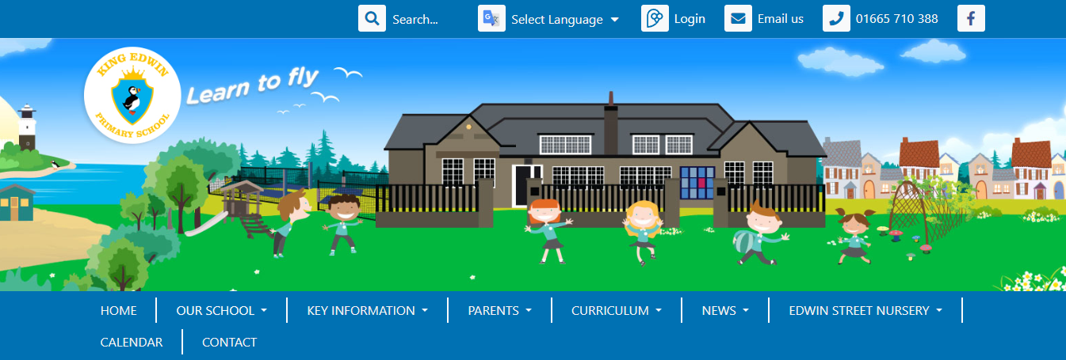
Curriculum
https://amble-first.eschools.co.uk/web
All of the information you need about school is available on our website.
There is a ‘curriculum’ tab where you will find the class pages
Notes:
Name of website will change soon!

Slide 19
School Behaviour Policy
We have 3 new rules to help everyone learn and feel happy:
✅ Be Ready
✅ Be Respectful
✅ Be Safe

Slide 20
What Happens if You Forget the Rules
😟 Sometimes we make mistakes. That’s OK — it’s how we learn!
Here’s what happens …

Slide 21
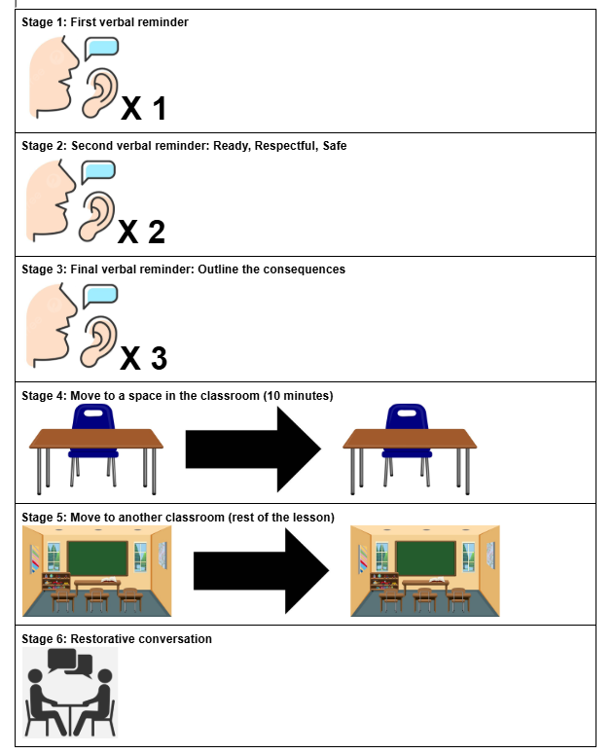
Staged response
For if you forget the rules.

Slide 22
Any Questions?

