Slide 1
KS1 Phonics
Screening Check

Slide 2
KS1 Phonics
What is phonics
and the screening check
How is phonics taught in school
How can you help

Slide 3
What is phonics?
Children are taught to read by breaking down words into separate sounds or ‘phonemes’. They are then taught how to blend these sounds together to read the whole word.
Children have a 45min RWI phonics lesson each day and they are encouraged to use these strategies to read and write in other lessons.
There are around 40 different sounds.

Slide 4
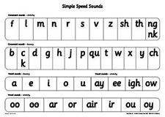

Slide 5
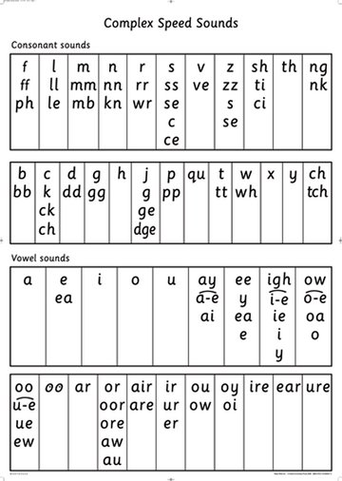

Slide 6
WHAT IS THE YEAR 1 PHONICS SCREENING CHECK?
The phonics screening check will be taken individually by all children in Year 2 (Autumn 2021 TBC) and Year 1 in June 2022.
It is designed to give teachers and parents information on how your child is progressing in phonics. It will help to identify whether your child needs additional support at this stage so that they do not fall behind in this vital early reading skill.

Slide 7
HOW IS THE PHONICS SCREENING CHECK COMPLETED?
There will be two sections in this 40-word check and it will assess phonics skills and knowledge learnt in KS1. Your child will read up to four words per page for their teacher and they will probably do the check in one sitting of about 5-10 minutes.

Slide 8
WHAT SORT OF CHECK IS IT AND IS IT COMPULSORY?
It is a school-based check to make sure that your child receives any additional support promptly, should they need it. It is not a stressful situation as the teacher will be well-equipped to listen and understand your child’s level of skills. There will be a few practice words first to make sure your child understands the activity.
Children already complete these checks as part of their half term assessment.

Slide 9
WHAT WILL IT CHECK?
It will check that your child can:
Sound out and blend graphemes in order to read simple words.
Read phonically decodable one-syllable and two-syllable words, e.g. cat, sand, windmill.
Read a selection of nonsense words which are referred to as pseudo words.

Slide 10
WHAT ARE NONSENSE, PSEUDO OR ALIEN WORDS AND WHY ARE THEY INCLUDED?
These are words that are phonically decodable but are not actual words with an associated meaning e.g. brip, snorb. Pseudo words are included in the check specifically to assess whether your child can decode a word using phonics skills and not their memory.

Slide 11
WHAT ARE NONSENSE, PSEUDO OR ALIEN WORDS AND WHY ARE THEY INCLUDED?
The pseudo words will be shown to your child with a picture of a monster. This not only makes the check a bit more fun, but provides the children with a context for the nonsense word which is independent from any existing vocabulary they may have.
Crucially, it does not provide any clues, so your child just has to be able to decode it. Children generally find nonsense amusing so they will probably enjoy reading these words.

Slide 12
IS THERE A PASS MARK?
Currently, the pass mark for the last 5 years has been 32 out of 40. Children progress at different speeds so not reaching this score does not necessarily mean there is a problem. Your child will re-sit the check the following summer term in Year 2 or Year 3.

Slide 13
WHEN WILL THE
SCREENING TAKE PLACE?
The screening will take place throughout the week beginning TBC for Year 2.
The screening will take place throughout the week beginning Monday 19th June for Year 1.
The children cannot retake the test at any other time so it is very important your child is in school during this week.

Slide 14
HOW CAN I HELP
Digraph- 2 letters making one sound = cow
Trigraphs- 3 letters making one sound = night
Split digraphs- 2 vowels with a consonant in between. Use to be known as the magic e!
spine - ine
Encourage your child to ‘sound out’ when reading or writing. Focusing particularly on spotting more unusual sound patterns.

Slide 15
HOW CAN YOU HELP
Encourage your child to use their sound mat when writing and use their actions to find the sound they need.
Children can practise their phonics by playing games online. Use Phonicsplay or School360 Busythings
Check school website information on REMOTE learning for resources and videos to help practise all sounds.

Slide 16
PLEASE REMEMBER
Phonics is not the only thing needed to become a fluent reader. Please continue to read with your child each night and encourage them to:
Sound out (where possible)
Re-read to check it makes sense.
Use pictures for clues.
Ask questions about the book.
Read stories to them as well as listening to them read
And most importantly ENJOY READING!

Slide 17
QUESTIONS?

