Slide 1

Respect Happiness Growth
Lower Key Stage 2 2026-27

Slide 2
Teachers
Year 3:
Miss Bowden (autumn term)
Mrs Balding (spring / summer terms)
Year 4:
Mrs Metcalfe
Supported by Mrs Durham and Mrs Oman

Slide 3


Communication
If you have a concern and would like to speak to your child’s class teacher you can pass on a message via a member of staff on the door in the morning, contact us via the school office or we will be on the yard at the end of the day.
Our next parents’ evening appointments will be the week commencing Monday 12th October. This will be a chance for you to hear about how your child has settled in this term.
We have our school Facebook newsfeed on our school website. We use this to share information and photographs of your child’s learning.

Slide 4

Walking home and mobile phones
🚶🏼‍♂️‍➡️In Year 4 pupils can develop their independence by walking home with your permission - there is a form for you to sign in the school office if you would like your child to walk home.
📱 They may bring a mobile phone into school but it is turned off and handed in as they come into school, stored in the office and returned as they leave for home.

Slide 5

Responsibilities
Children are expected to organise their own belongings in the morning and remember to bring reading books into the classroom everyday. Please help them by encouraging them with this responsibility at home.
We give children responsibilities in the classroom such as register monitor, organising resources etc to help children become more independent. We have elected our half termly team RRS - ready, respectful, safe.

Slide 6

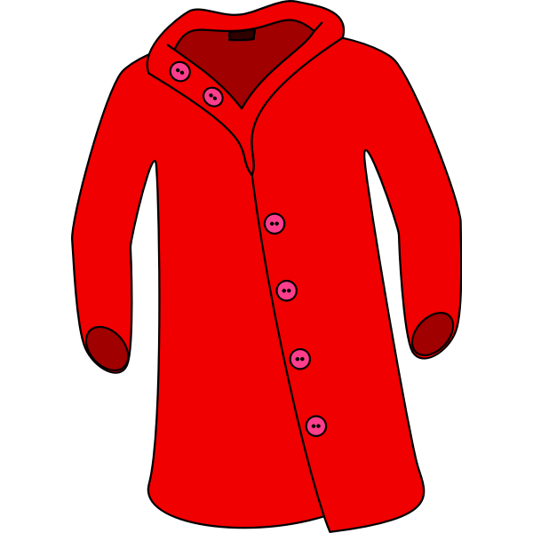

Reminders
Belongings & Uniform
Bring a coat daily; hats and gloves will be needed soon.
Label all uniform and belongings.
Bring a named water bottle (water only, refillable in school).
No earrings. Plastic retainers can be worn if piercings are new.
Only small bags (e.g. book bags) due to cloakroom space.
Any medication must go to the school office—children should not carry it

Slide 7
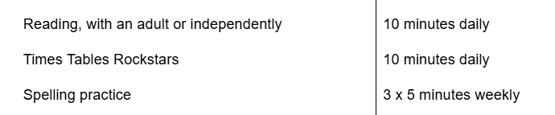
Home learning
Home learning is the same as last year.
Each half term, your child will receive a letter, outline a project that they should complete. This does not normally need handing in until the last week of term.
The project is additional to the weekly homework expectations.
Year 3/4 Expectations

Slide 8
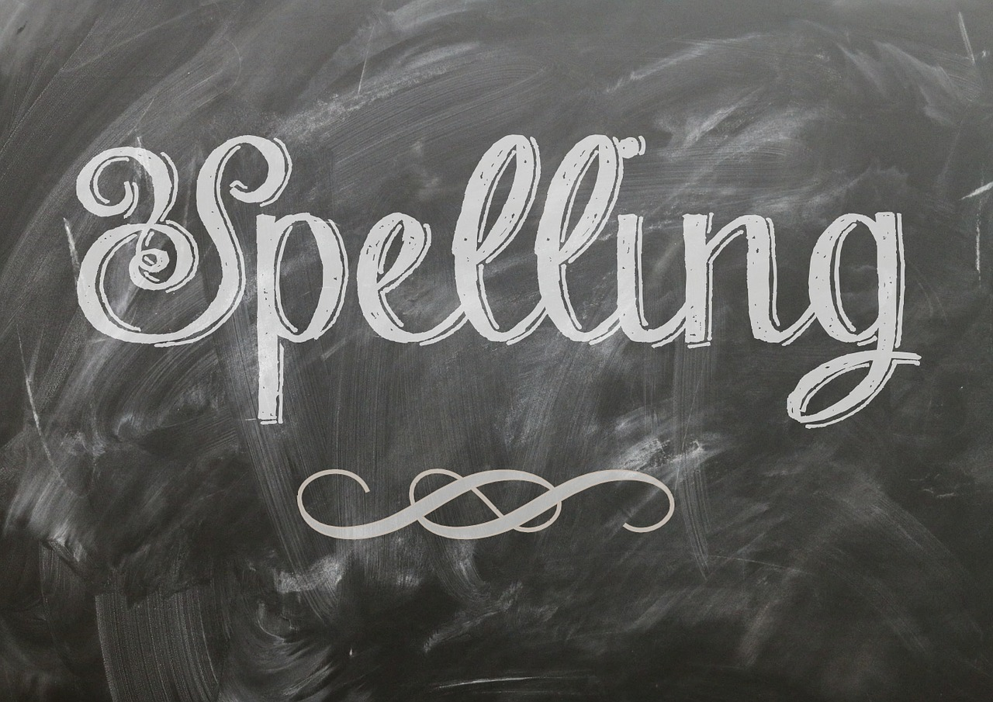

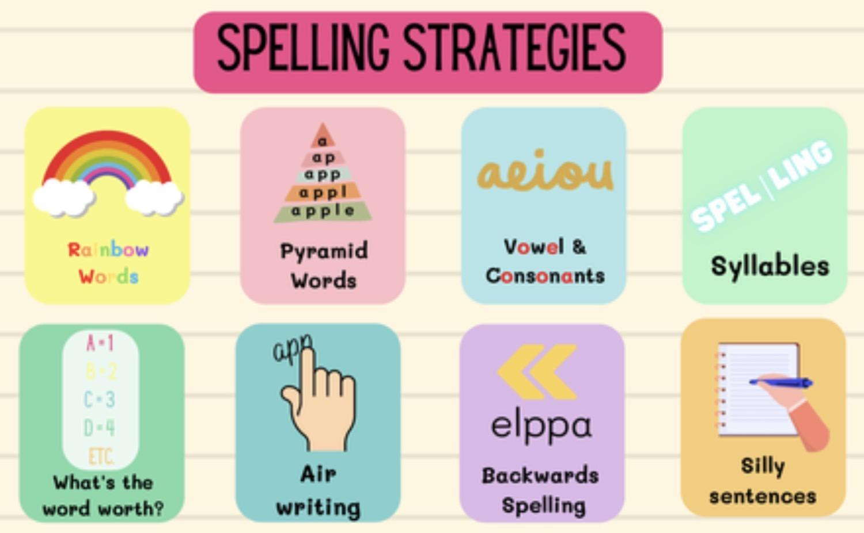
Spellings
Children will be given spellings to learn each week. These are based on our lower key stage 2 curriculum. We encourage them to practice these as often as possible- a couple of minutes a day can make a big difference!
Top tips for spelling!
Highlight any “special friends” p l ay
Fred Talk the sounds p l ay
Write out the word
Look, say, cover, write, check

Slide 9

Homework: Reading
“Reading helps children build essential language skills, grow their imagination, and succeed in school”
📚 Reading books: children will bring home two books at the start of the year. One will be matched to their reading ability and the other will be a book of their choice from the library.
In an ideal week we would like every child to read aloud at home a minimum of 4 times and record this in their home/school reading records. We would also like the book and record returned every day 😊 Reading records are regularly checked in school and link to the new reading challenge.
When you listen to your child read please talk to them about what they have read - can they tell you what has happened or predict what might come next? This will help their comprehension skills.
Your child is encouraged to independently change their reading book when it is finished - this might be every day or once a week depending on the length of the book!
📖 Library books: The children are asked to share these at home with you and their wider family before returning them. Once their library book is returned a new one can be selected. Year 3 usually visit the school library every Friday. Year 4 on Wednesdays.

Slide 10

Times Tables
In Year 4 the children will take part in the Multiplication Check. This involves a 25 question timed assessment in June.
Please support your child during Year 3 and Year 4 with their times tables. This includes regularly logging on to and playing TTRS.
We will have opportunities to report on your child's progress throughout the year at parents evenings and in their end of year report.

Slide 11

Uniform/PE days
Our PE days this half term are:
Year 3: Monday and Wednesday
Year 4: Wednesday and Friday
PE days change from term to term depending if children are working with the coaches from NUFC. We will let you know when PE days change.
Children need to wear the school’s PE kit that day which is; black leggings / joggers, trainers, a white t-shirt and plain black hoodie.
Jewellery must not be worn in school. Plastic earring retainers may be worn in place of earrings.

Slide 12
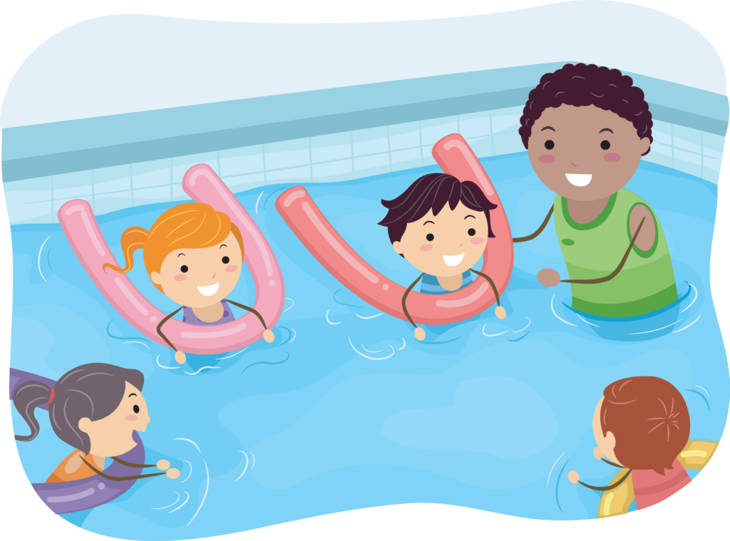
Swimming
Year 4 will swim in Spring term.
A letter will be sent out nearer the time to explain what your child will need to bring to school.

Slide 13
Attendance
Every day counts!
We know that sometimes children are unwell or things happen that are out of our control. Thank you for working with us to make sure your child gets the most from their time at school.
If your child is absent
Please let school know as soon as possible if your child is going to be absent. This helps us avoid having to contact you.
Please let us know each day your child is absent, unless you have already agreed otherwise with school.
Please give us an honest reason for your child's absence. Please don't encourage your child to give a different reason – this can make things uncomfortable for everyone, and we will usually need to clarify the circumstances.

Slide 14
Being on time
Being late can be unsettling for children and can be awkward when they arrive after the rest of the class has started.
Even a short amount of missed time can mean missing important learning and routines.
If your child arrives late, please come to the office where you have to report your reason for being late.

Slide 15
Attendance matters
If attendance falls below 92%, we will contact you to discuss this.
Attendance below 90% is classed as persistent absence and will be monitored closely.
Holidays during term time
If you need to request a holiday during term time, please complete a holiday request form at least 2 weeks in advance.
Please remember that holidays during term time are not automatically authorised.

Slide 16
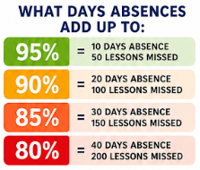

Slide 17


Online Safety
We teach children about online safety throughout the year and we also have a whole school assembly each half term covering a range of themes.
If you have any concerns about online safety or need general advice…
To report any concerns/incidences regarding your child’s safety:
Parents and carers | CEOP Education
https://www.ceop.police.uk/Safety-Centre/

Slide 18
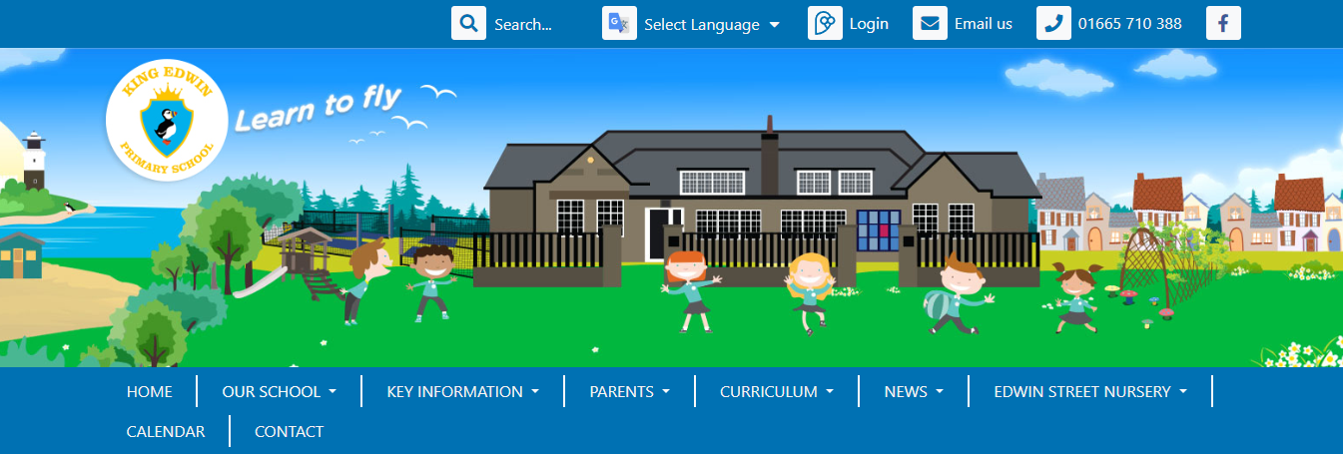
Curriculum
http://www.amblefirst.northumberland.sch.uk/web
All of the information you need about school is available on our website.
There is a ‘curriculum’ tab where you will find the class pages

Slide 19
Whole-School Behaviour Policy
We have 3 rules to help everyone learn and feel happy:
✅ Be Ready
✅ Be Respectful
✅ Be Safe

Slide 20
✅ Be Ready
Be Ready means:
🎒 Bring what you need to school
👂 Listen carefully
🙋 Be ready to learn and try your best

Slide 21
✅ Be Respectful
Be Respectful means:
🙂 Be kind to everyone
🗣️ Use polite words
👫 Take turns and share

Slide 22


✅ Be Safe
Be Safe means:
🚶 Walking sensibly in and around the school
🙋 Tell an adult if something’s wrong
🤲 Keep hands and feet to yourself
Using equipment and furniture safely

Slide 23
What Happens if You Forget the Rules?
😟 Sometimes we make mistakes. That’s OK — it’s how we learn!
Here’s what happens …

Slide 24
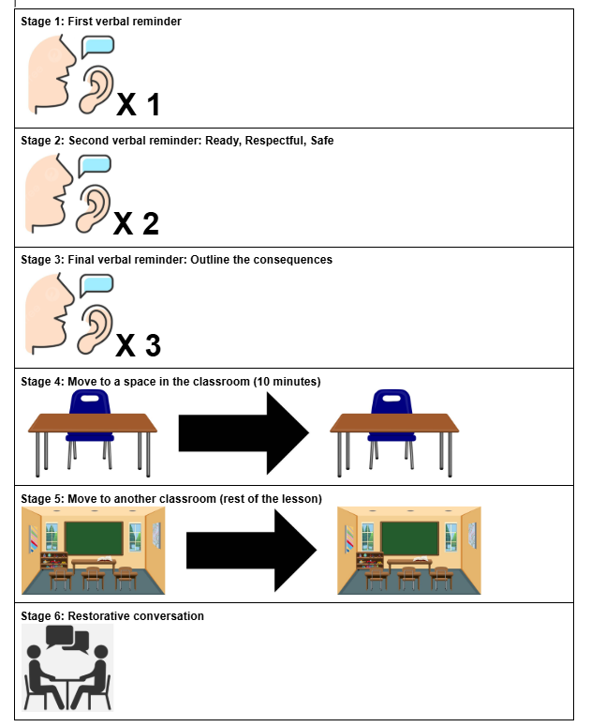
Staged response
For if you forget the rules.

Slide 25
Any Questions?

